Slide 1
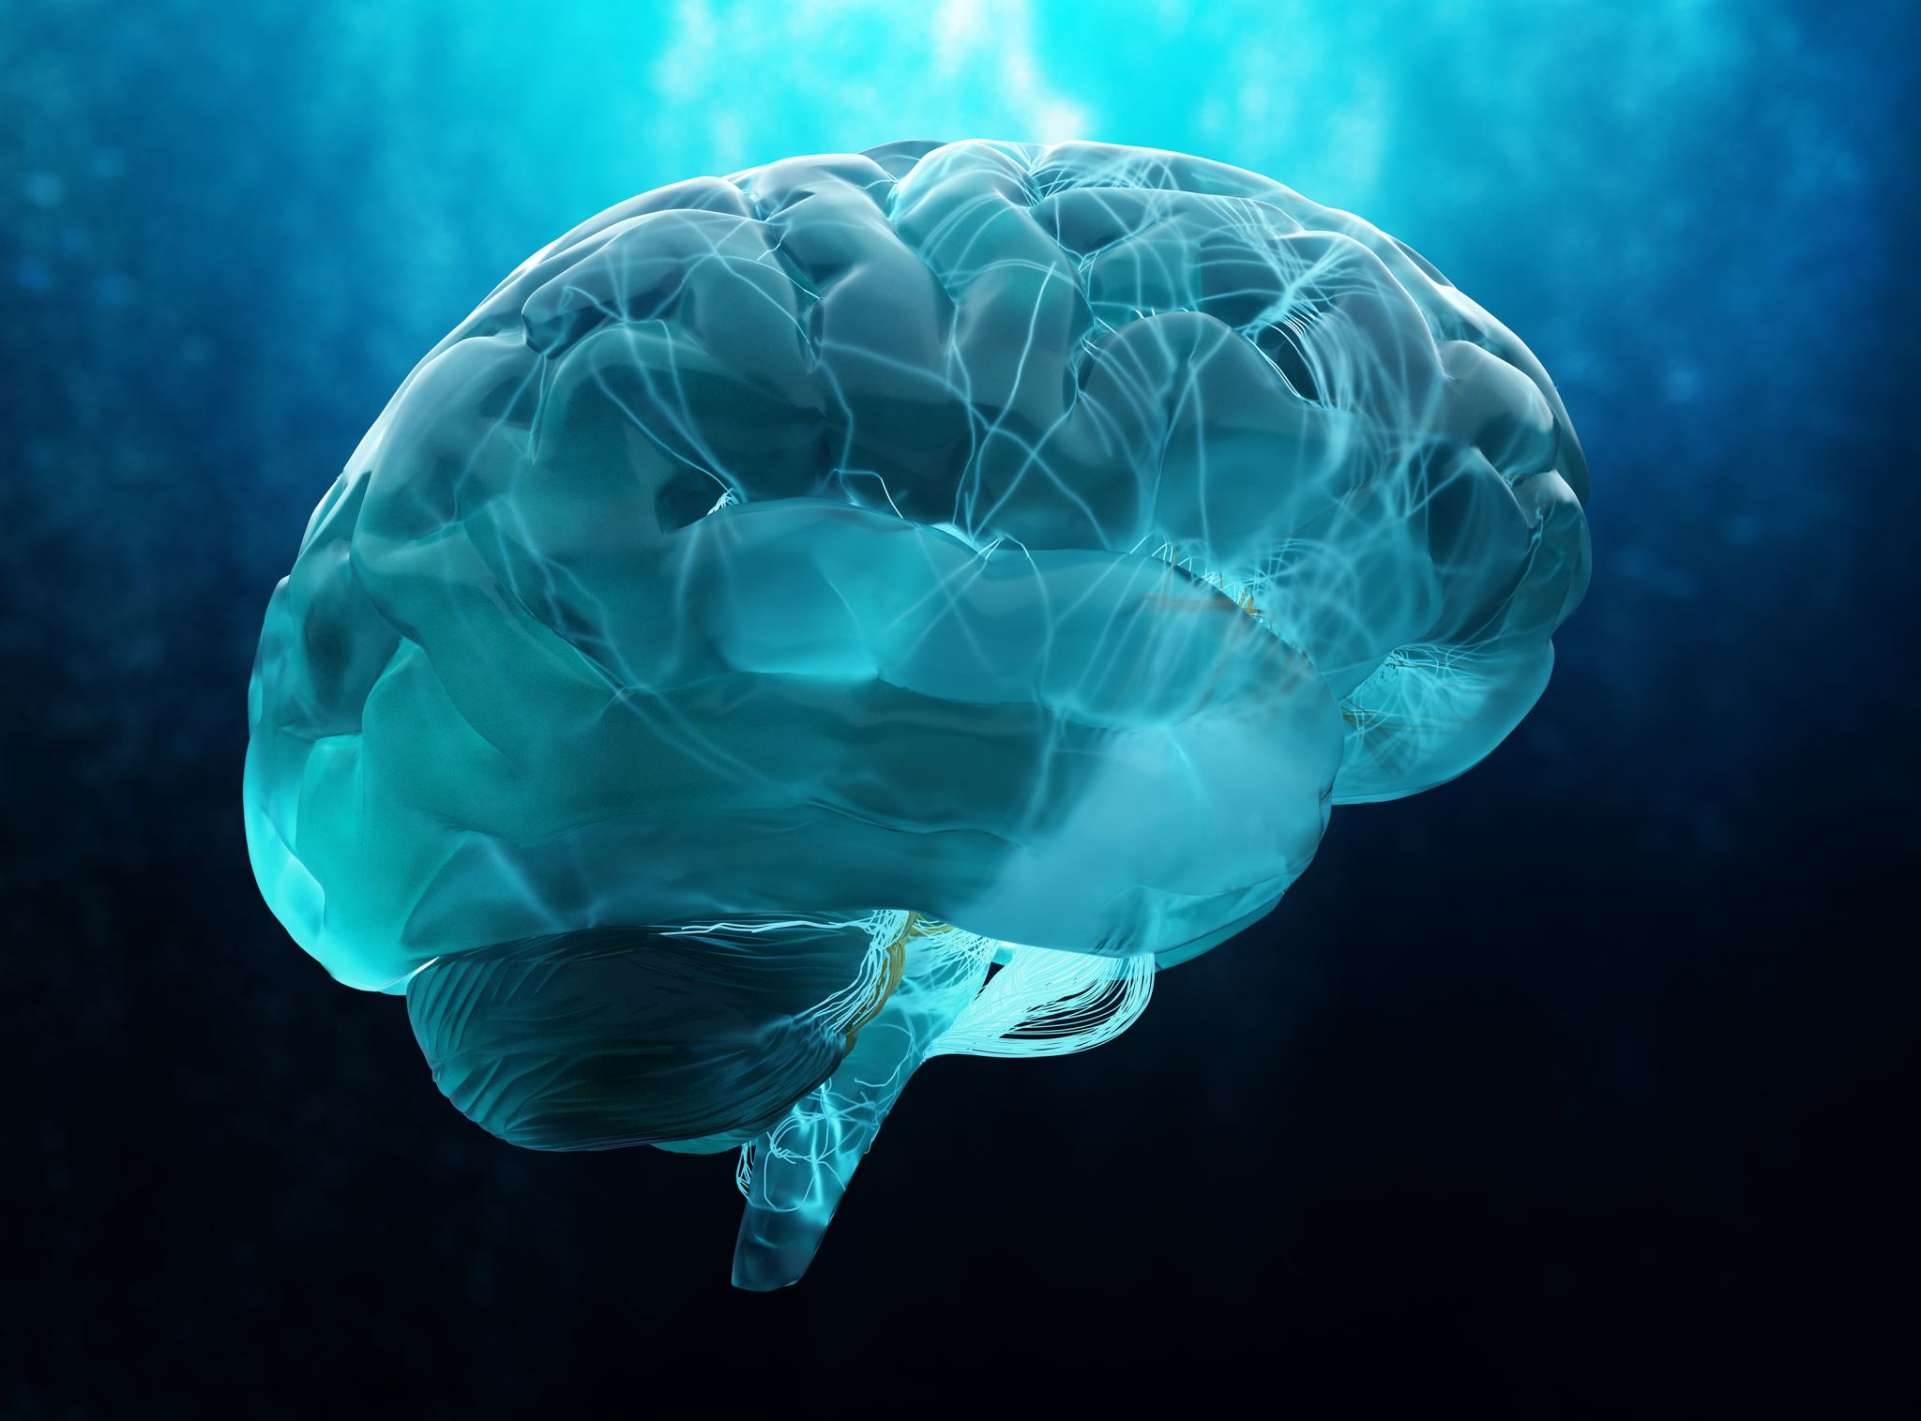

Trial data in brain tumours ​​
Dr Matt Williams

Slide 2




Trial Evidence for Optune
Dr. Matt Williams
Matthew.Williams@imperial.ac.uk
Optune Day Dec 2023
Charing Cross Hospital, ICHNT

Slide 3
Aims
Epistemology: How do we know what we know?
CLINICAL TRIALS & Parachute
What can trials tell us and what can’t they tell us?
What do we know about Optune?
How do we translate this to practice?
What can we tell patients?
This is NOT a Novocure medical training session

Slide 4
How do we know the truth?
Bad things happen
There it lots of variation in outcomes
So how do you know if doing X makes things better?
We cannot accurately predict outcomes
Therefore you cannot tell if doing X made outcomes better

Slide 5
How do we deal with this?
We run clinical trials
Where we RANDOMLY assign patients to treatment
And then assess outcomes
And, if we can, BLIND people to intervention and outcomes

Slide 6
Why randomise and blind?
Randomise because otherwise we make (subconscious) decisions about who might benefit/ do well/ cope with treatment
  E.g. offer more aggressive treatment to younger/ fitter patients
  Therefore they live longer – but due to age and fitness, not treatment
Blind because otherwise if we ask people about (e.g.) symptoms then we might steer their responses based on treatment
  E.g. if we know that treatment X has certain side-effects, then we might ask about those side-effects, and not others

Slide 7
Beyond blinded RCTs
Blinding is more important the more subjective the assessment
  Symptoms, QoL – important to try to do blinded
Cannot blind to all treatments (surgery, RT – and Optune!)
Assessment of Death is not very likely to be influenced
  Assessment of “Cause of death” may be: e.g. “Neurological death”
Not EVERYTHING needs to be done in an RCT….

Slide 9
The parachute fallacy
Most treatments are not parachutes
Everything that is not a parachute should probably be tested in an RCT
COVID stress-tested this approach to medicine

Slide 10
Optune RCT data
There are two major RCTs of Optune in GBM
EF-14
  Newly diagnosed GBM, offered Stupp regimen +/- Optune
EF-11
  Relapsed GBM, offered chemo vs. Optune
There is also a Systematic Review

Slide 11
EF 14
Multicentre, open label Phase 3 RCT
GBM, chemo-RT.
  At end of CRT: 2:1 Randomisation to TMZ & Optune vs. TMZ alone
  6 cycles of TMZ, more if local practice allows
  At PD, clinician choice of therapy; TTF continued until second progression
  MRIs every 2 months (blinded assessment)
Stupp et al., Jama 2017

Slide 17
EF-14 criticisms
Single trial, not MA
Not blinded (but OS is primary outcome)
Skin toxicity
It is NOT a parachute
Impact of TTF is still less than other prognostic factors

Slide 18
EF-11
Relapsed GBM
Previous RT (+/- chemo ) and previous therapies
1:1 randomisation to chemo (physician choice) vs. Optune (no chemo)
237 patients
Primary endpoint OS
80% were at second recurrence (or more)

Slide 22
EF-11 results
Optune is no worse than chemo in this group
It isn’t really better
Results are miserable in multiply-relapsed GBM
Optune & Chemo have different side-effects – probably better off combining

Slide 23
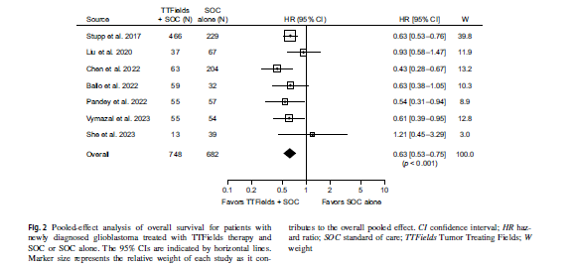
SYS REVIEW ADD
Ballo et al, JNO, 2023

Slide 24
Implications
Optune works for GBM
It works better upfront than for multiply relapsed disease
  But that is true for ALL therapies in GBM
It is not a parachute
Wear-time probably matters
So maybe we need to focus on getting the device onto people, and keeping them using it

Slide 25
Implications
I am aware of the licensed indications
Much of being a consultant is knowing when to break the rules
For relapsed disease, chemo + Optune is probably a better option
People with missing bone flaps CAN tolerate Optune
  Just look after their skin!
For MGMT methylated GBM, CRT with TMZ + Lomustine is probably better, so now TMZ, Lomustine + Optune

Slide 26
How to approach patients’ needs
Optune does work
It is a hassle
It is expensive
BUT seems to work across MGMT methylated/ unmethylated, old/young
BUT it is not a panacea
  Young patient MGMT methylated IDH-mut “GBM” is “doing well” with Optune

Slide 27
Questions

Slide 28
Trial updates: completed, ongoing and upcoming
Dr Matt Williams

Slide 29




Recent, Ongoing and upcoming trials
Dr. Matt Williams
Matthew.Williams@imperial.ac.uk
Optune Day Dec 2023
Charing Cross Hospital, ICHNT

Slide 30
Aims
Talk a little about what has finished recently, or is coming
Talk about what future trials are coming
Talk about where this might put the evidence
Cannot cover all of the trials, and not all data is out

Slide 31
List of trials
TRIDENT - GBM
EF-33 - GBM
METIS – Brain Mets
2-THE-TOP - GBM
LUNAR - NSCLC
KEYNOTE B36 - NSCLC
PANOVA – 3 - Pancreas
INNOVATE –3 - Ovarian
ZL-8301-001 – Gastric

Slide 32
Trial Status
TRIDENT – GBM – 950 pts ALMOST complete
EF-33 – GBM – Single centre; 25 pts
METIS – Brain Mets; 270 pts; complete
2-THE-TOP – GBM; 26 pts; complete
LUNAR – NSCLC; 276 patients; complete
KEYNOTE B36 – NSCLC 66 patients - ongoing
PANOVA – 3 – Pancreas; 556 patients; complete
INNOVATE –3 – Ovarian; 540 patients; complete
ZL-8301-001 – Gastric; 28 patients; complete

Slide 33
TRIDENT Trial
EF-14 showed that adding TTF to newly diagnosed GBM patients improved survival
BUT Adj TMZ starts ~ 10 weeks after CRT starts
So, can we bring TTF forward?

Slide 34
TRIDENT Trial 2
Large, international multi-centre trial
  950 pts
Randomised 1:1 to TTF on D1 of CRT vs. On D1 of Adj TMZ
EVERYONE gets TTF
Primary outcomes are OS
  Secondary are PFS, RANO, SAEs, etc.
  950 pts
Large attraction for the UK – Everyone gets TTF

Slide 35
INNOVATE-3
540 patients with locally advanced ovarian cancer
Platinum-resistant
Paclitaxel vs. Paclitaxel + TTF
No difference in OS
Maybe improved OS in 1st line

Slide 36
2-The-Top
26 patients with newly diagnosed GBM
Single arm, non-randomised
CRT; Adj TMZ + Optune + Pembrolizumab
73% MGMT unmethylated; 46% GTR
PFS 12 months; OS: 24 months
  (Better than matched controls from EF-14 TMZ & Optune arm)
Shows potential synergy between TTF and immunotherapy
https://ascopubs.org/doi/abs/10.1200/JCO.2023.41.16_suppl.2024

Slide 37
METIS
270 patients with NSCLC & 1 – 10 Brain mets
SRS vs. SRS + TTF
Completed recruitment in March 2023
Median OS is ~ 13 months in this group
So maybe some results ~ASCO 2024?
May see an immunotherapy interaction as well

Slide 38
EF41/Keynote D58 trial
Improved survival with Optune & Pembrolizumab in NSCLC
2-The-Top looked promising, so...
Newly diagnosed GBM
  CRT and TTF after CRT
  Randomised to +/- Pembrolizumab

Slide 39
Looking forwards
Trials are expensive to run
And take a lot of time, effort, and patient input
So, where are the gaps?
Recurrent GBM
Older patients
Previous trials in recurrent disease have been disappointing

Slide 40
Questions

