Slide 1
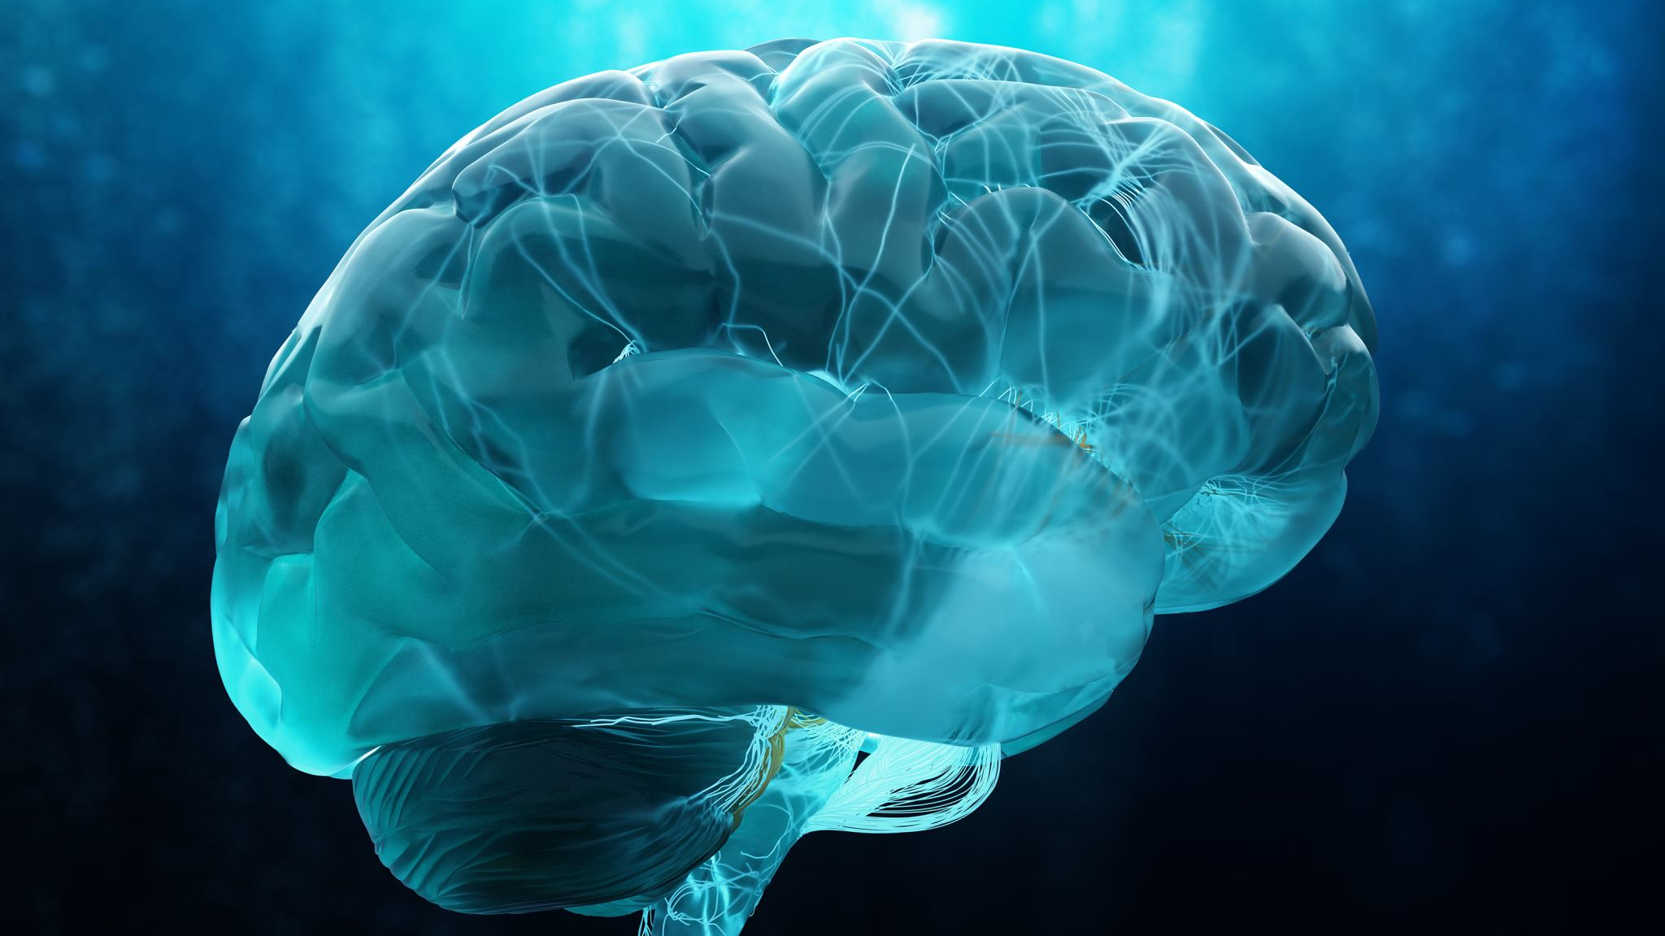
Practicalities of using Optune
Ms Shivani Soni

Slide 2
Practicalities of of Optune

Slide 3
What is OPTUNE
Also known as Tumour treating fields, is a non-invasive technique for treating adults with a glioblastoma.
It works by alternating electrical fields which pulse through the scalp
It selectively targets tumour cells by disrupting cell division, and/or causes cell death
Normal adult brain cells divide slower than tumour cells, so are thought not to be affected by TTF.
The idea being to delay tumour regrowth
combine this with standard cancer treatments

Slide 4
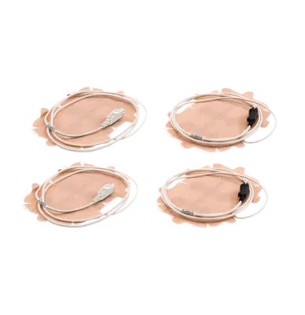
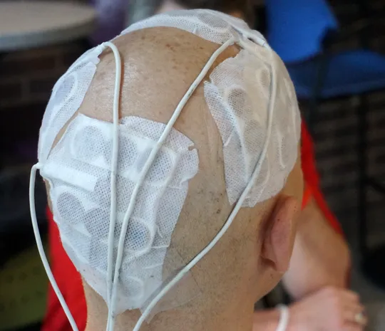
How does it work?
adhesive patches that hold insulated ceramic discs, called ‘transducer arrays’ onto the scalp
Usually 4 arrays are used
The arrays are attached by wires to a portable device that is carried
Optune has to be worn continuously, and for at least 18 hours per day
The arrays have to be changed a few times per week, to make sure a good contact is maintained with the skull.

Slide 5
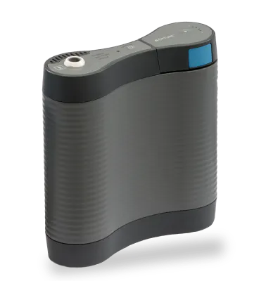
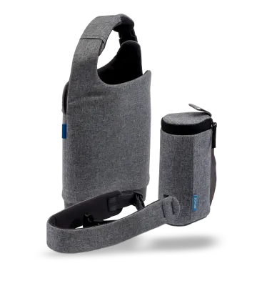
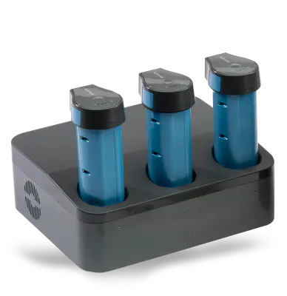
The device
Portable device carried throughout the day – weighs around 2kg
Portable batteries and a charger for these are provided along with mains power supply- batteries last a few hours
bag to carry device

Slide 6
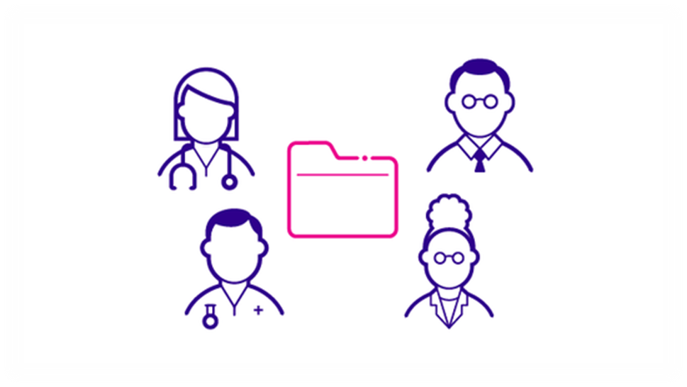
What are the problems?
It is a hassle
It is expensive
Extra work for healthcare professionals
In reality it takes time To adjust to something new and find a
Rhythm

Slide 7
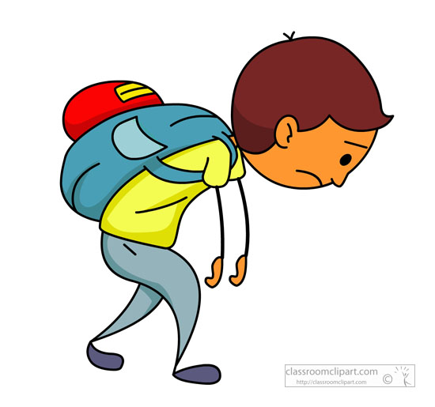
main implications
While Optune has a survival advantage it is not without its day to day challenges:
Needing someone to help change the electrodes
Preparing the skin regularly i.e. shaving ones head
Cultural religious implications
Body image
Frequency
Skin Irritation
Weight of carrying the pack
Impact on ADLs e.g. dressing etc
Stigma
Talking to children

Slide 8
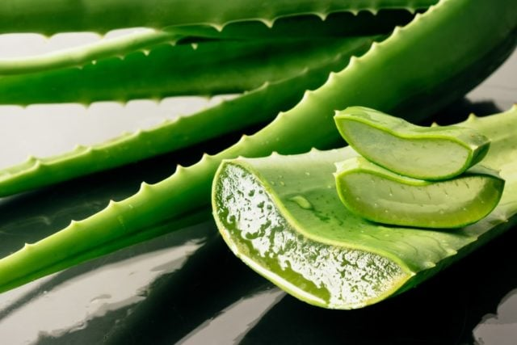
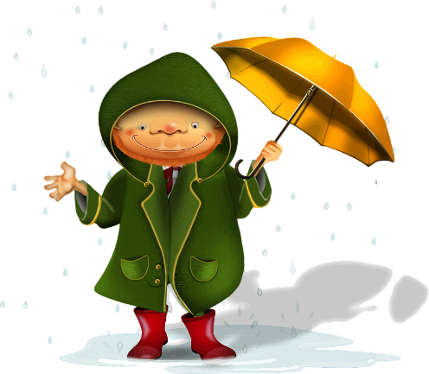
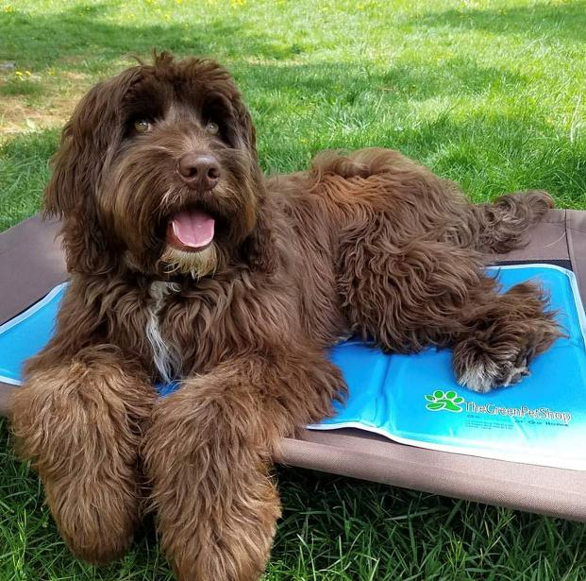
Tips and tricks
Experiment with shaving techniques
Wet/dry
Cooling gel e.g. Aloe Vera
Pet cooling Mats for the summer
Headgear e.g. beanie hats keeps electrodes in place and disguises the device
Waterproofing when it rains
Customising back packs:
Tool belt to carry device at hip level

Slide 9
Support
Support from Novocure via the device support specialist
Optune Support Group - RUN BY myself, MW, and LPS
Optune Whatsapp group/emailing list for patient and carers supported by LPS

Slide 10
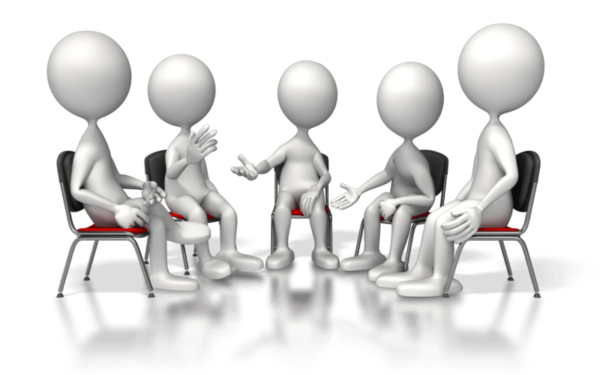
Optune Support Group
We run the Uk’s only Optune Support Group- online via zoom
Run by Dr Williams and myself and Lillie
Split into 2 sections:
Closed Support Group for those using the device (1hr)
Open section (new users/interested healthcare professionals to attend)
Shared learning among patients/carers
Shared practical tips
Psychological support
Discussion point: frequency of group

Slide 11
Summary
Just to recap:
Practical issues
Common barriers/implications for patients
Some ways to address them
Please use the OSG

Slide 12
Questions

