Slide 1
Optune in Lung Cancer
Dr Waleed Mohammed

Slide 2
Optune In lung cancer
Dr Waleed Mohammed
Tuesday, 12th December 2023
Charing Cross Hospital
Imperial College Healthcare NHS Trust

Slide 3
CONTENTS
Lung cancer characteristics
Types of Lung cancer and treatments
Standard of Care (SoC) in advanced Lung cancer
OPTUNE in Lung cancer
Outcome of LUNAR 1 trial
Aim of LUNAR 2 trial
Outcome of STELLAR trial
Implications for patients at Charing Cross Hospital
Questions

Slide 4
LUNG CANCER CHARACTERISTICS
In UK 48,000 people per year are diagnosed with lung cancer (44 % in > 75 y/o)
52 % men and 47 % women
2nd most common cancer (after breast cancer)
The most common (UK and global) cause of cancer death
35,000 deaths per year (1/5th of all cancer deaths)
More women die of lung cancer than breast cancer
> 70 % caused by smoking
Remaining a combination of passive smoking, work exposure to gas/chemicals/radiation, air pollution etc.
Much lower risk in non-smokers
After quitting smoking, an ex-smoker’s risk drops to match a non-smoker’s risk after 15 years
Symptoms lead to late presentation
Cough/blood, breathlessness, chest pain or no symptoms
> 40 – 60 % of people are already Stage 4 (incurable) at diagnosis

Slide 5
LUNG CANCER TYPES & TREATMENTS
Primary vs. Secondary
Non-Small Cell Lung Cancer (85 %) vs. Small Cell Lung Cancer (10 %)
Mesothelioma and Neuro-Endocrine Tumours
Advanced/Metastatic/Stage 4 (incurable) vs. Early (curable)
Chemotherapy/Immunotherapy/Tablets vs. Surgery or Radiotherapy
Future of Early (curable) lung cancer
Targeted screening for Lung cancer in the UK
To detect disease at earlier stage, therefore allow more curative treatment
55 – 74 y/o with ‘high risk’
Invited to CT scan
Future of Advanced/Metastatic/Stage 4 (incurable) lung cancer
Metastatic lung cancer patients are in need of new treatments

Slide 6
SoC IN ADVANCED NSLC
Combination of Chemotherapy (Platinum based) + Immunotherapy (Pembrolizumab)
Delivered on the Chemotherapy Day Unit as an outpatient every 3 weeks
6-hour infusion per session
Total course of treatment lasts up to 2 years
(Unless disease progression or unacceptable side effects)
Treatment differs depending on patient fitness and Immunohistochemistry/NGS profile
Chemotherapy alone
Immunotherapy alone
Oral targeted therapy

Slide 7
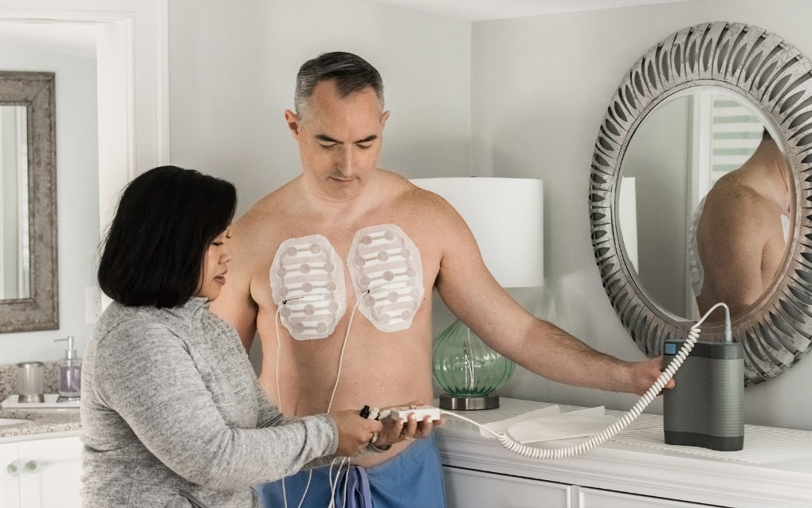
OPTUNE IN LUNG CANCER
Wearable skin patches that deliver electrical fields to disrupt cancer cell division.
The device is worn for approximately 18 hours per day, at any time of day.
150 kHz with NovoTTF-200T device.

Slide 8
LUNAR 1 (RANDOMIZED PHASE 3 TRIAL)
Metastatic NSCLC who progressed on platinum chemotherapy
Patients aged ≥22 yr with metastatic NSCLC and progression on/after platinum-based therapy;
ECOG PS 0-2
(N = 276)
TTFields 150 kHz ≥18 hr/day with NovoTTF-200T device +
SoC Therapy*
(n = 137)
Follow-up Q6W until PD; 3 postprogression follow-up visits; survival follow-up
SoC Therapy*
(n = 139)
*Investigator’s choice of ICI (Pembrolizumab, Nivolumab, or Atezolizumab) or Docetaxel
Primary endpoint: Overall survival (OS)
Key secondary endpoints: OS in IO and Docetaxel-treated subgroups
Other secondary endpoints: PFS, ORR, PFS/OS by histology, QoL, safety
Notes:
DMC, data monitoring committee; ECOG, Eastern Cooperative Oncology Group; IA, interim analysis; ICI, immune checkpoint inhibitor; NSCLC, non-small-cell lung cancer; ORR, objective response rate; OS, overall survival; PD, progressive disease; PFS, progression-free survival; PS, performance status; QoL, quality of life; SoC, standard of care; TTFields, tumor-treating fields.

Slide 10
OUTCOME OF LUNAR 1 TRIAL
Phase 3 trial testing the effectiveness/safety Optune
Experimental Arm: Optune with Immunotherapy (Pembrolizumab) or Chemotherapy (Docetaxel)
Control Arm: Immunotherapy (e.g. Pembrolizumab) or Chemotherapy (Docetaxel) alone
Statistically significant and clinically meaningful results + No added systemic toxicities
Adding Optune to SoC extended survival by 3.3 months
13.2 months compared to 9.9 months
Adding Optune to Immunotherapy extended survival by 7.7 months
18.5 months compared to 10.8 months
Adding Optune to Chemotherapy extended survival by 2.4 months
11.1 months compared to 8.7 months

Slide 11
LUNAR 1 TRIAL RESULTS
1.0
 | TTFields + SoC (n = 137) | SoC (n = 139)
Median OS, mo (95% CI) | 13.2 (10.3-15.5) | 9.9 (8.1-11.5)
 | HR: 0.74 (95% CI: 0.56-0.98; P = .035)
1-yr survival, % | 53 (95% CI: 44- | 42 (95% CI: 34-50)
3-yr survival, % | 18 (95% CI: 11-27) | 7 (95% CI: 2-15)
0.8
0.6
Probability of OS
0.4
TTFields + SoC
0.2
SoC
0
0
6
12
18
24
30
36
42
48
54
Mo
Patients at Risk, n
TTFields + SoC
SoC
137
139
100
96
62
54
36
32
22
16
16
7
11
3
9
0
5
0
3
0
Notes:
f/u, follow up; ITT, intention-to-treat; OS, overall survival; SoC, standard of care; TTFields, tumor-treating fields.

Slide 12
 | TTFields + ICI (n = 66) | ICI (n = 68)
Median OS, mo (95% CI) | 18.5 (10.6-30.3) | 10.8 (8.2-18.4)
 | HR: 0.63 (95% CI: 0.41-0.96; P = .03)
1-yr survival, % | 60 (95% CI: 47-71) | 46 (95% CI: 33-57)
3-yr survival, % | 27 (95% CI: 15-42) | 9 (95% CI: 3-21)
 | TTFields + DTX (n = 71) | DTX (n = 71)
Median OS, mo (95% CI) | 11.1 (8.2-14.1) | 8.7 (6.3-11.3)
 | HR: 0.81 (95% CI: 0.55-1.19; P = .28)
1-yr survival, % | 46 (95% CI: 33-57) | 38 (95% CI: 27-49)
3-yr survival, % | 9 (95% CI: 3-20) | 5 (95% CI: 0-18)
1.0
1.0
0.8
0.8
0.6
0.6
Probability of OS
Probability of OS
0.4
0.4
TTFields + ICI
0.2
0.2
TTFields + DTX
ICI
DTX
0
0
0
6
12
18
24
30
36
42
48
54
0
6
12
18
24
30
36
42
48
54
Mo
Mo
TTFields + ICI
ICI
TTFields + DTX
DTX
66
68
50
49
35
29
24
21
16
11
12
6
8
3
6
0
2
0
1
0
71
71
50
47
27
25
12
11
6
5
4
1
3
0
3
0
3
0
2
0
Notes:
DTX, docetaxel; ICI, immune checkpoint inhibitor; OS, overall survival; TTFields, tumor-treating fields.

Slide 13
AIM OF LUNAR 2 TRIAL
LUNAR 1 was the first phase 3 clinical trial in more than 7 years to show a significant improvement in survival in advanced/metastatic/Stage 4 NSCLC
How far up the treatment algorithm is benefit observed?

Slide 15
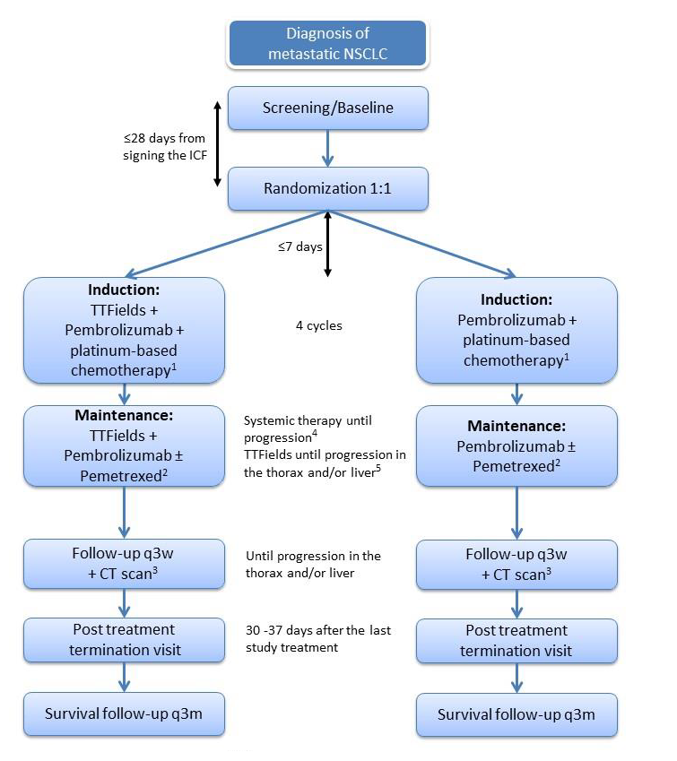

Slide 16
AIM OF LUNAR 2 TRIAL
LUNAR 1 was the first phase 3 clinical trial in more than 7 years to show a significant improvement in survival in advanced/metastatic/Stage 4 NSCLC
How far up the treatment algorithm is benefit observed?
We are hoping to be the first UK centre to recruit to LUNAR 2
Pre-study site visit was on 8th December 2023

Slide 17
MESOTHELIOMA; STELLAR TRIAL
Prospective, single-arm phase 2 trial
Optune with Pemetrexed + Platinum in unresectable mesothelioma
Average survival in mesothelioma is 9 months without chemotherapy (12 months with)
Primary endpoint: OS
Secondary endpoints: PFS, ORR, safety
After CT was completed, TTFields maintenance continued until PD, patient of physician decision, or unacceptable toxicity
Adults with unresectable malignant pleural mesothelioma, PS 0/1
(N = 80)
TTFields 150 kHz ≥18 hr/day with NovoTTF-100L device
+
Pemetrexed 500 mg/m² + Cisplatin 75 mg/m² OR
Pemetrexed 500 mg/m² + Carboplatin (AUC 5)
on D1 of a 21-day cycle (max 6 cycles, in absence of PD)
Notes:
AUC, area under curve; CT, chemotherapy; ECOG, Eastern Cooperative Oncology Group; MPM, malignant pleural mesothelioma; ORR, objective response rate; OS, overall survival; PD, progressive disease; PFS, progression-free survival; PS, performance status; TTFields, tumor-treating fields.

Slide 18
MESOTHELIOMA; STELLAR TRIAL
Overall Survival
Progression-Free Survival
100
100
75
75
OS (%)
50
PFS (%)
50
25
25
Median OS: 18.2 mo (95% CI: 12.1-25.8)
Median PFS: 7.6 mo (95% CI: 6.7-8·6)
0
0
0
6
12
18
24
0
3
6
9
12
n
(no. censored)
Mo
n
(no. censored)
Mo
80 (0)
74 (1)
43 (8)
20 (25)
12 (31)
80 (0)
68 (10)
48 (18)
21 (19)
10 (19)
STELLAR phase 2 results have not been translated to NHS, but adopted in the USA and Hong Kong.
No comparator arm. Phase 3 data needed.
Notes:
OS, overall survival; PFS, progression-free survival.

Slide 19
TAKE HOME MESSAGES
Lung cancer is the most deadly cancer in the UK (and globally)
Most common Lung cancer is Stage 4 NSCLC, which needs new treatments
LUNAR 1 trial (met its end point) has set up upcoming LUNAR 2 trial
We are aiming to be first LUNAR 2 trial centre in the UK
(Principle Investigator Dr Waleed Mohammed)
Campaign to adopt Optune for mesothelioma patients in UK

Slide 20
SUMMARY & QUESTIONS
Lung cancer characteristics
Types of Lung cancer and treatments
Standard of Care (SoC) in advanced Lung cancer
OPTUNE in Lung cancer
Outcome of LUNAR 1 trial
Aim of LUNAR 2 trial
Outcome of STELLAR trial
Implications for patients at Charing Cross Hospital
Questions

Slide 21
Lunch and Healthcare Professional Seminar sponsored by Novocure

Slide 22
Getting started; Things I wish I knew; Talking to family & friends​​
Panel discussion

